Slide 1
State space search

Slide 2
Principles of a production system by example: Water Jug Problem
Problem: given two water jugs (4 liter & 3 liter); neither has any measuring markers on it. there is a pump that can use to fill the jugs with water. How can you get exactly 2 liter water in 4 liter jug?
Solution:
Let us assume that x & y represents the content of 4L and 3L jugs respectively.
The content of the two jugs will be represented by (x, y). The set of possible PRs are listed below.
(x, y) if x < 4 → (4, y) = fill the 4 gallon jug.
(x, , y) if y < 3 → (x, 3) = fill the 3 gallon jug.
(x, y) if x > 0 → (x-d, y) = pour some water out of the 4 gallon jug.
(x, y) if y > 0 → (x, y-d) = pour some water out of the 3 gallon jug.
(x, y) if x > 0 → (0, y) = empty the 4 gallon jug on the ground.
(x, y) if y > 0 → (x, 0) = empty the 3 gallon jug on the ground.

Slide 3
7. (x, y) if x + y → 4 & y > 0 = (4, y-(4-x)) = pour water from 3L jug into 4L jug until the 4L jug is full.
8.(x, y) if x + y → 3 & x > 0 = (x-(3-y), 3) = pour water from 4L jug into 3L jug until the 3L jug is full.
9.(x, y) if x + y <= 4 & y > 0 → (x + y, 0) = pour all the water from 3L jug to 4L jug.
10.(x, y) if x + y <= 3 & x > 0 → (0, x + y) = pour all the water from 4L jug to 3L jug.
11.(0, 2) = (2, 0) = pour the 2L from 3L jug to 4L jug.
12.(2, y) = (0, y) = empty the 2L in the jug on the ground.

Slide 4
One solution
4L 3L rule applied
0 0
2
0 3
9
3 0
2
3 3
7
4 2
5 or 12
0 2
9 or 11
2 0
To keep track of the reasoning process, we draw a state-space for the problem. The leaves generated after firing of the rules should be stored in WM.

Slide 5
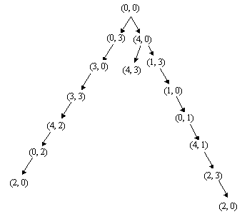

Slide 6
2. Can Solution steps be ignored or undone?
Recoverable problem: in which solution steps can be undone.
Ex:- The 8-Puzzle
The 8-puzzle is a square tray in which are placed, eight square tiles and remaining 9th square is uncovered. Each tile has number on it. A tile that is adjacent to blank space can be slide in to that space. A game consist of a starting position and a specific goal position.
We might make stupid move.
We can backtrack and undo the first move. Mistakes can still be recovered from but not quite as easy as in theorem proving.
2
8
3
1
2
3
1
6
4
8
4
7
5
7
6
5
Initial State
Goal state

Slide 7
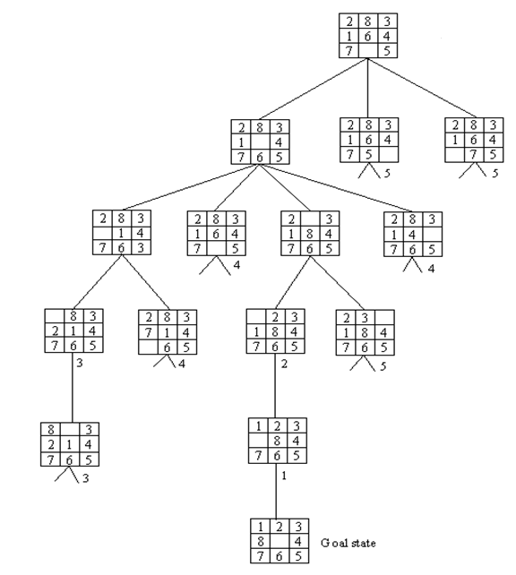
8-Puzzle -------------------------------

Slide 8


